Slide 1
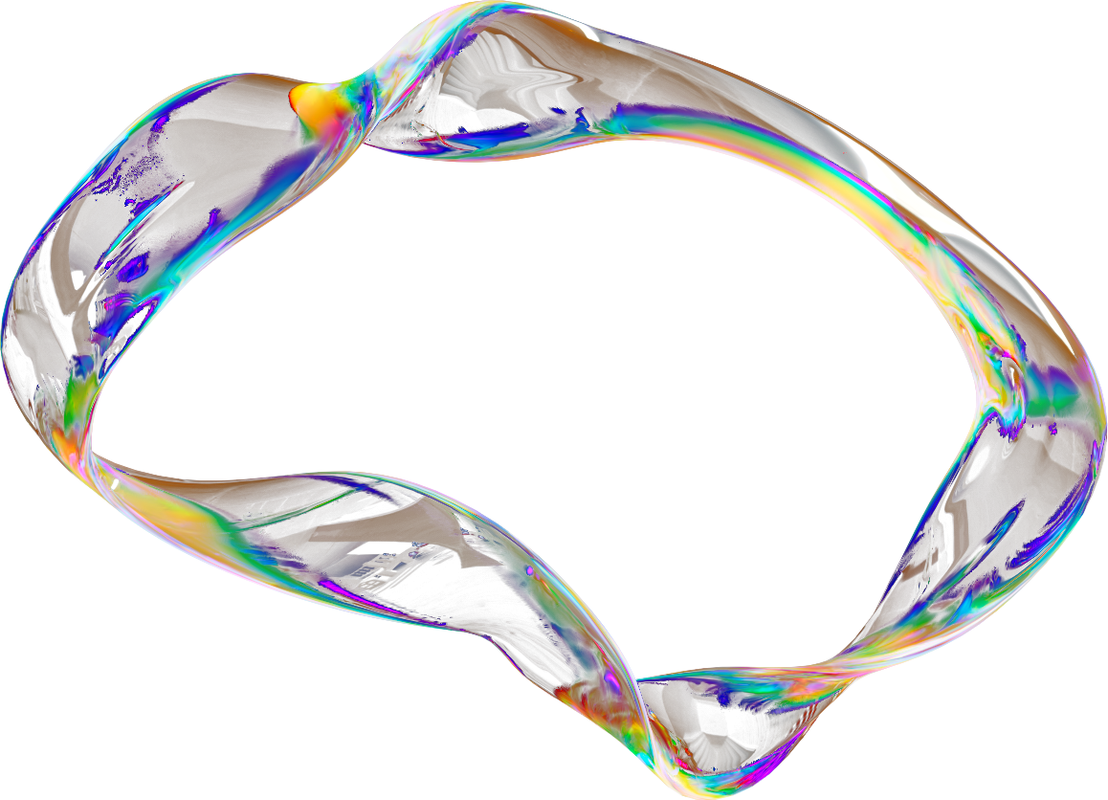




PENTAGON
ALCHEMY
VELOCITY
LOCAL HOST.....
8p.akash2008@gmail.com
NITW

Slide 2
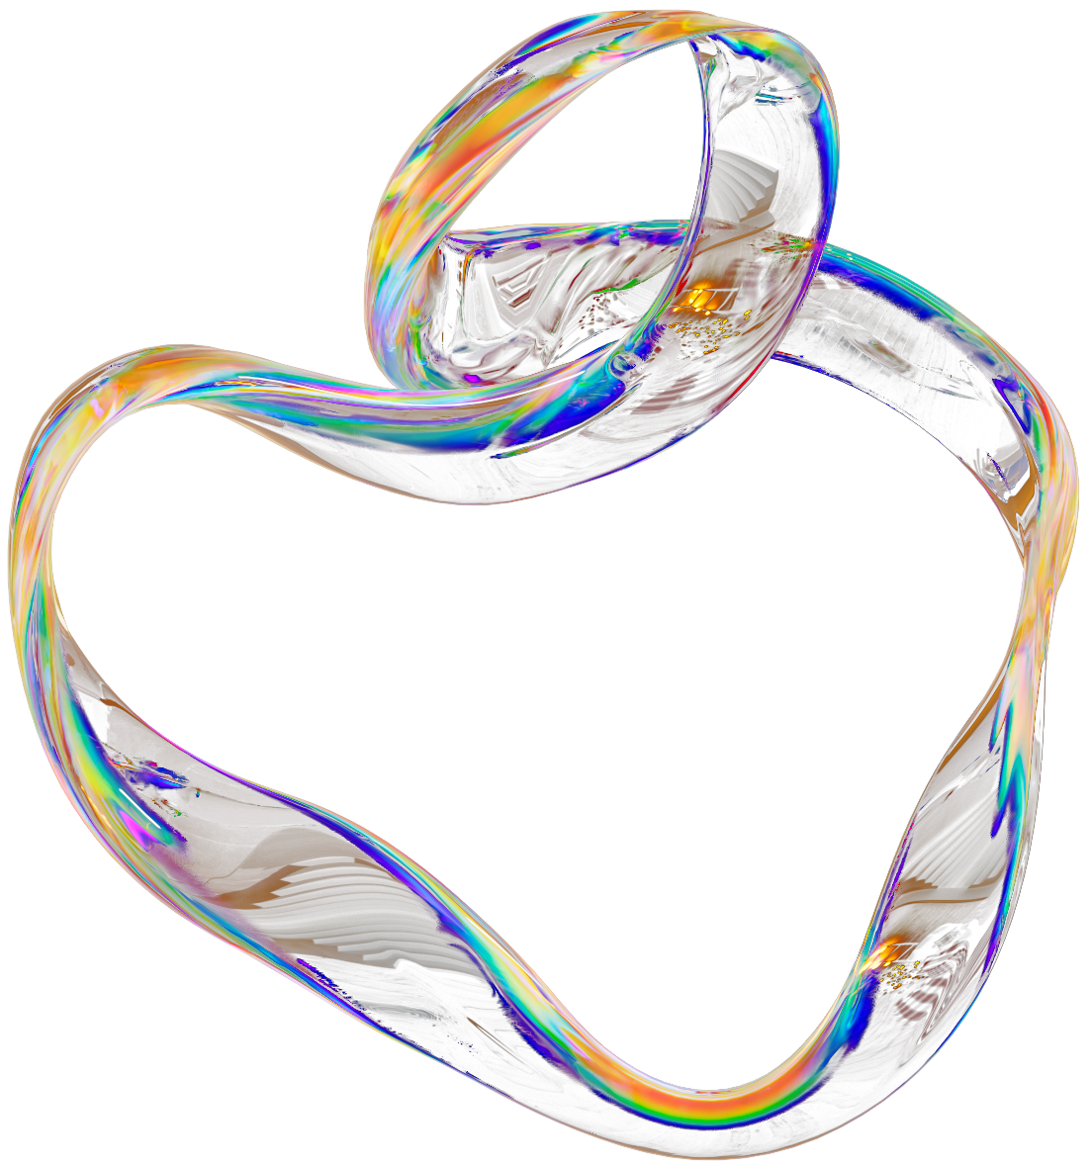

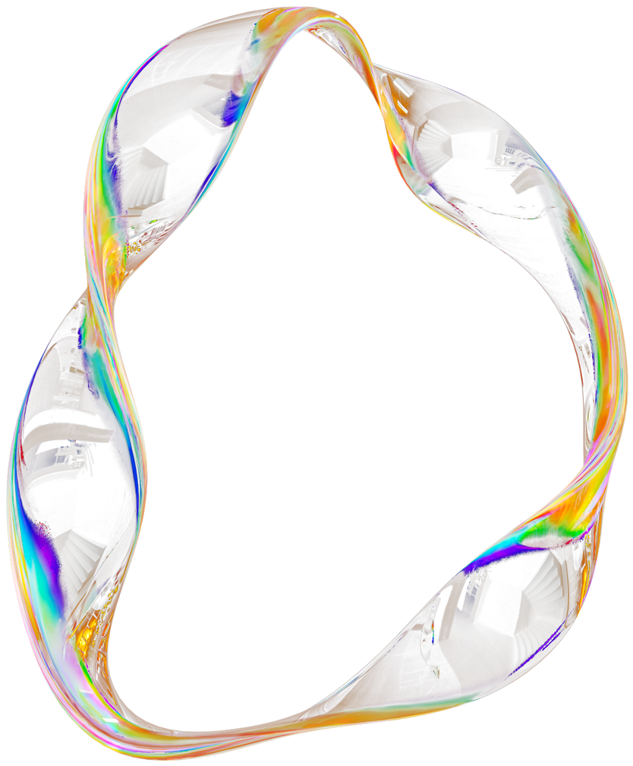
TEAM PENTAGON
⭐ Team Introduction
We are a four‑member team combining creativity, logic, and strong collaboration to build a completely functional generative‑AI tool within 24 hours. Each of us brings a unique skillset that fits perfectly into the project:
👑 Mahesh – Project Lead & Integration
Keeps the team aligned, defines the scope, and connects the frontend with the backend.
Ensures the project works smoothly as one complete system.
👨‍💻 Suhas – Backend & AI Logic
Builds the Flask API, designs the AI‑assisted content‑generation logic, and
makes sure every prompt produces meaningful and stable output.
🎨 Soham – Frontend & UI Developer
Creates the entire website interface using HTML and CSS, building a clean and
user‑friendly poster preview that makes the project visually strong.
🧪🎤 Akash – Testing & Pitch
Tests the system to prevent demo failures, prepares the documentation, and
delivers the final pitch with clarity and confidence.

Slide 3

INTRODUCTION
Marketing design can be challenging for people who don’t have design skills or access to professional tools. Creating posters, banners, or promotional content often takes time, effort, and familiarity with complex software.
Our project solves this challenge by introducing a generative AI tool that transforms simple text prompts into ready‑to‑use marketing content. Instead of spending time on design decisions, users can input a short description, and the system instantly generates a headline, tagline, and call‑to‑action placed within a clean poster layout. The goal is to make design accessible, fast, and intuitive for everyone — especially those with no design background.

Slide 4

Lack of Design Differentiation
Non designers often find it hard to make their design unique in a crowded market. Without a clear way to stand out, they struggle to catch the eye of potential customers and lose out to bigger competitors.
Inconsistent Brand Messaging
Inconsistency in brand messaging across various marketing channels confuses potential customers and dilutes brand perception. Designers often face challenges in maintaining a cohesive message that effectively communicates their value proposition and resonates with their target audience.
“PEOPLE KNOW WHAT THEY WANT , BUT NOT HOW TO DESIGN IT.”
Keeping Up with Trends
The market changes fast, and designers need to keep up. But without a big team or resources, it's tough to stay on top of the latest trends and adapt their marketing strategies accordingly.

Slide 5




OUR INNOVATIVE SOLUTIONS
⭐ 1. Smart Keyword‑Driven AI Logic
⭐ 2. Instant Poster Preview Interface
⭐ 3. Prompt‑Based Marketing Content Generator
Your backend detects important keywords in the prompt (event, sale, school, product, launch, etc.) and uses dynamic templates to produce high‑quality marketing text.
The frontend transforms the generated text into a clean, structured, poster‑style preview, helping users visualize the final marketing material instantly.
Instead of requiring design knowledge, users simply type a short prompt, and the system intelligently generates headline + tagline + CTA instantly.

Slide 6
HOW IT WORKS?
PROMPT
FRONTEND ( HTML/CSS )
JavaScript
Our tool takes a short text prompt from the user and instantly converts it into marketing poster content. The frontend (HTML/CSS) collects the prompt, JavaScript sends it to our FastAPI backend, and the backend processes the text using lightweight AI logic. It then generates a headline, tagline, and call‑to‑action, which are sent back as JSON. The frontend displays these results in a clean poster preview, giving users an instant, ready‑to‑use marketing draft.
BACKEND ( FAST API)
AI LOGIC ( PYTHON )
JSON RESOPONSE
POSTER PREVIEW UI

Slide 7
PENTAGON
THANK YOU
for your time and attention
VELOCITY
LOCAL HOST.....
8p.akash2008@gmail.com
NITW

